Slide 1



uSpark
AI Medical Assistor
Sprint 2 Presentation
Team 1 – Rush Hour
CS691
April 2025

Slide 2

AGENDA
Team :
Roles and Responsibilities
Improvements
Project Overview:
Problem Statement
Project Description
Working Agreement
Personas
Product Design
MVP Design
Technology:
Technologies
Algorithms
Diagrams
Product Backlog
Sprint Backlog:
Backlog
Test Cases
Completed
Not Completed
Sprint 2 Metrics:
Velocity
Burndown Chart
Committed Ratio
Sprint 2 Retrospective
Sprint 3 Planning
Product Demo

Slide 3
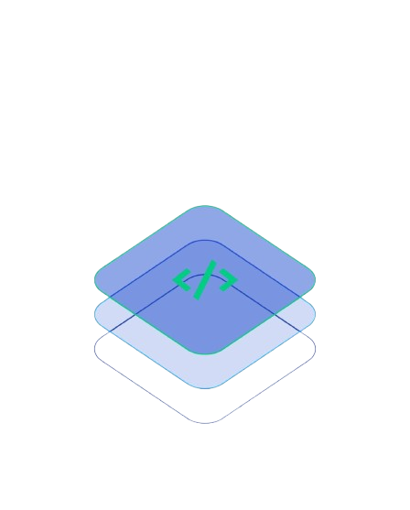
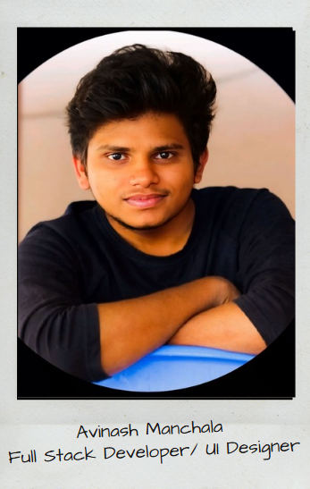
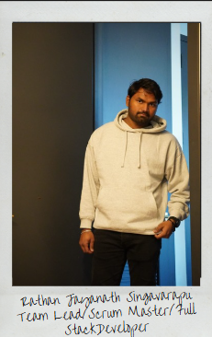
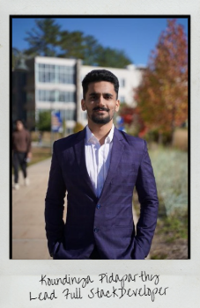
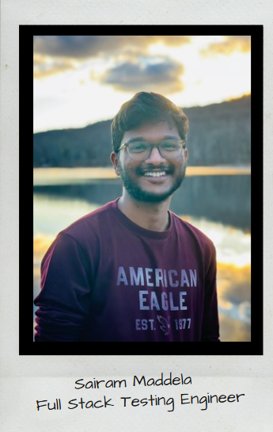
FULL STACK TEAM

Slide 4

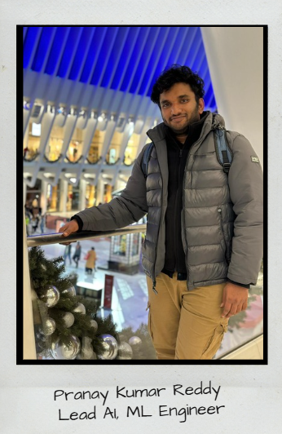
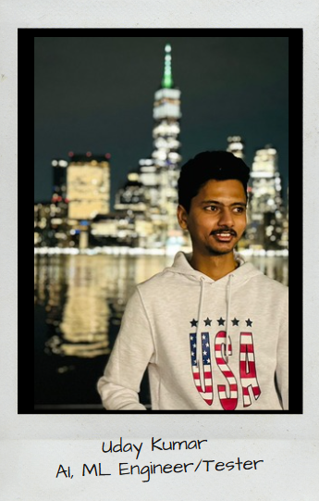
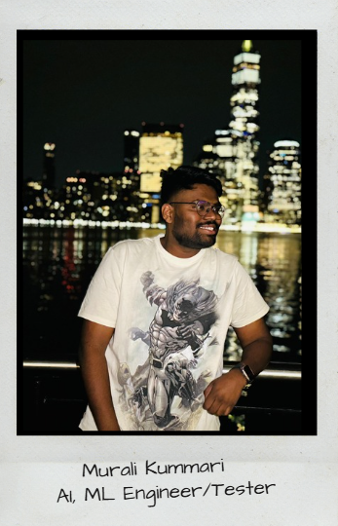
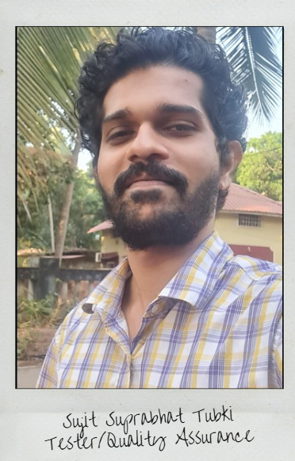
ML AI TEAM

Slide 5
Improvements from professor
Describe the features, technologies, and tools needed to describe why we are using it
improved product backlog by adding titles and removing the features
Modified the metrics and diagrams related to sprint based on the changes suggested
Change the test case id separate test case ID numbers

Slide 6
PROBLEM STATEMENT
Continuous Medical Assistance is one of a non-negotiable requirement these days and it can't be ignored. It is tedious to manage and store data related to a diagnosis of a patient for hospitals and for the patient as well. A simplified way of managing health care is needed, which can be achieved through AI chatbot and smart data storage system and like wise professionals in the medical sector can use a trained ML based algorithm service to reduce manual effort in the patient diagnosis.
This creates a hassle-free environment for both patient and doctors.

Slide 7
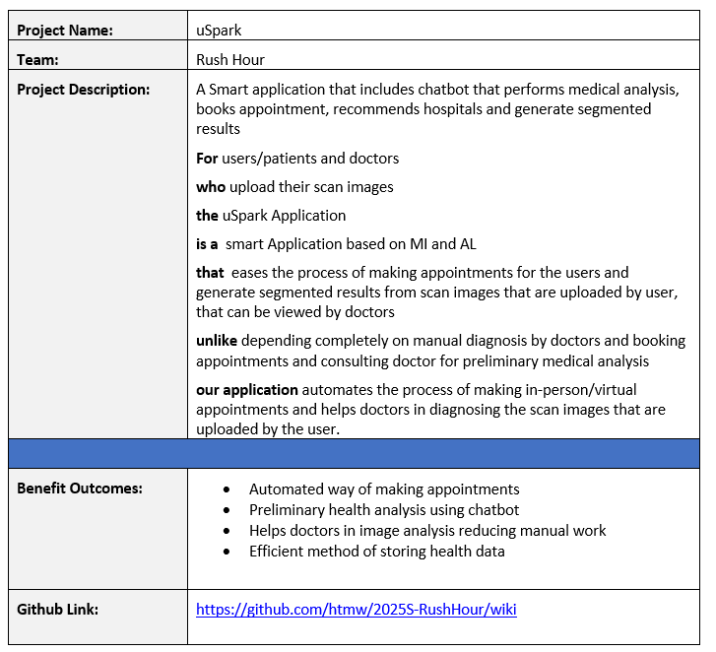
PROJECT DESCRIPTION
1

Slide 8
PROJECT DESCRIPTION
A robust approach to ease the process of health care and management with just one click!
➔“uSpark” is an Intelligent full stack application incorporated with machine learning that is an ultimate go-to point for the users/patients for all their healthcare related issues. uSpark allows users to schedule appointments in a hassle-free manner.
➔ These appointments can be virtual or in-person using “Uheal” a smart chatbot in the application that diagnoses the patient condition with the help of few questions. uSpark stores all the assessment details of the patient for further usage.
➔ Doctors can use uSpark as their personal virtual assistant that helps them in their work for managing appointments and patients records. It provides doctors with “Useg” a well-trained ML algorithm that precisely processes bio-medical images that produces an output

Slide 9
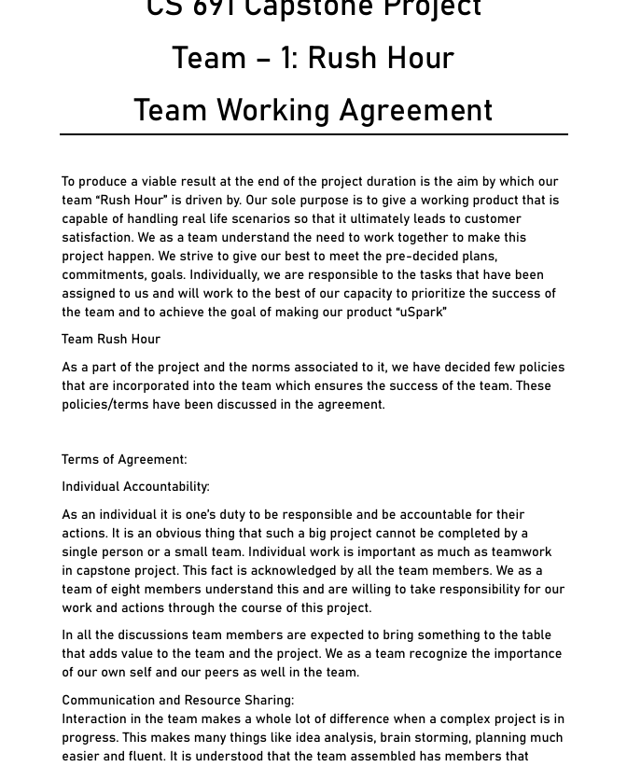
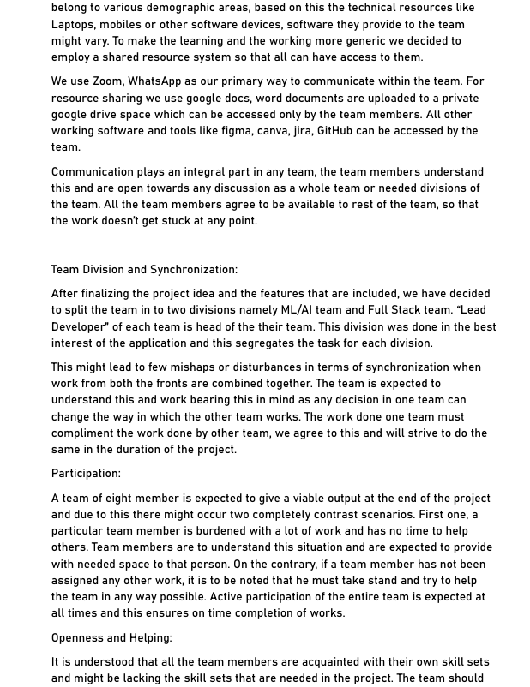
Team Working Agreement
Link:
Team working agreement
1

Slide 10
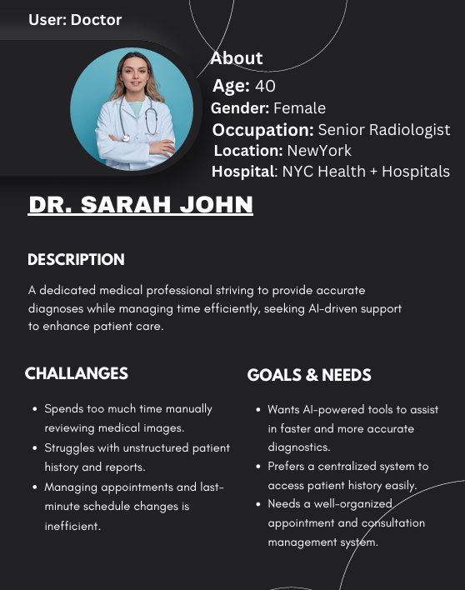
Persona 1
1

Slide 11
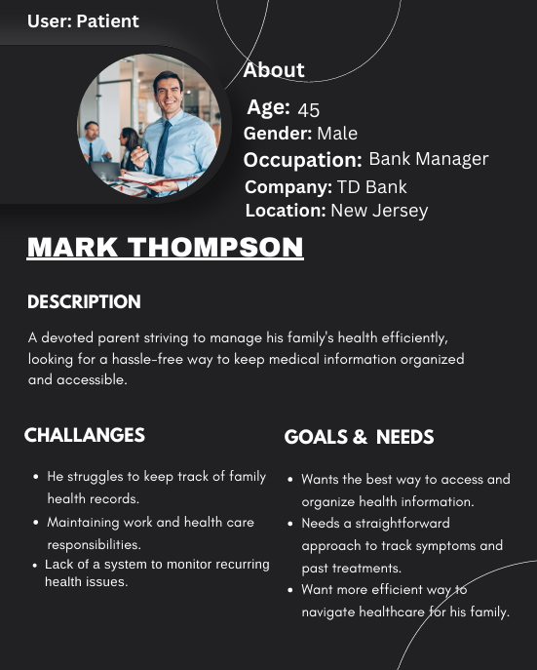
Persona 2
1

Slide 12
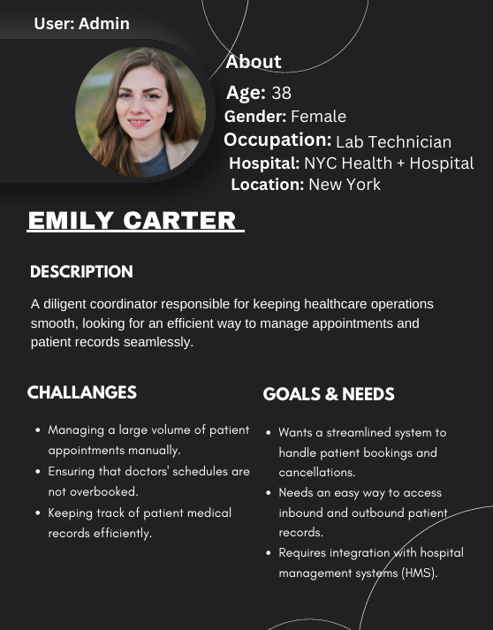
Persona 3
1

Slide 13
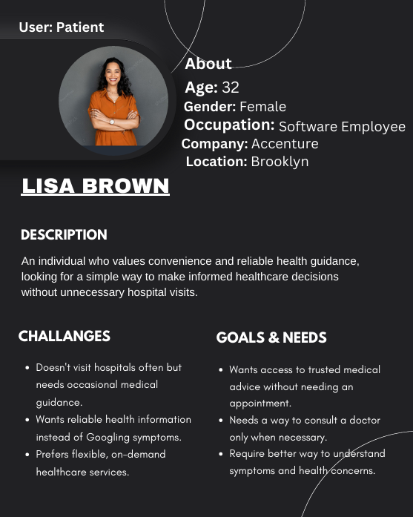
Persona 4
1

Slide 14

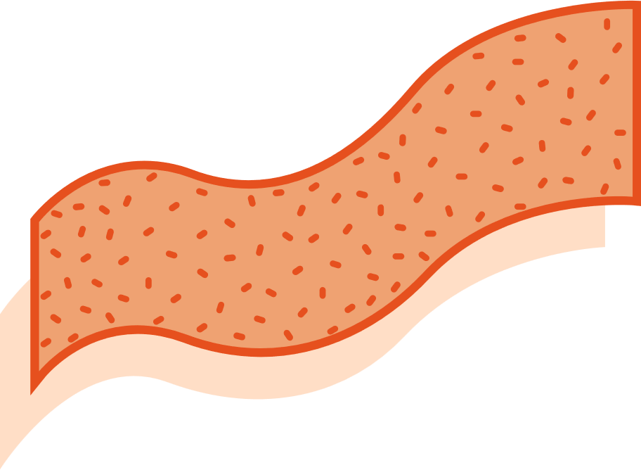




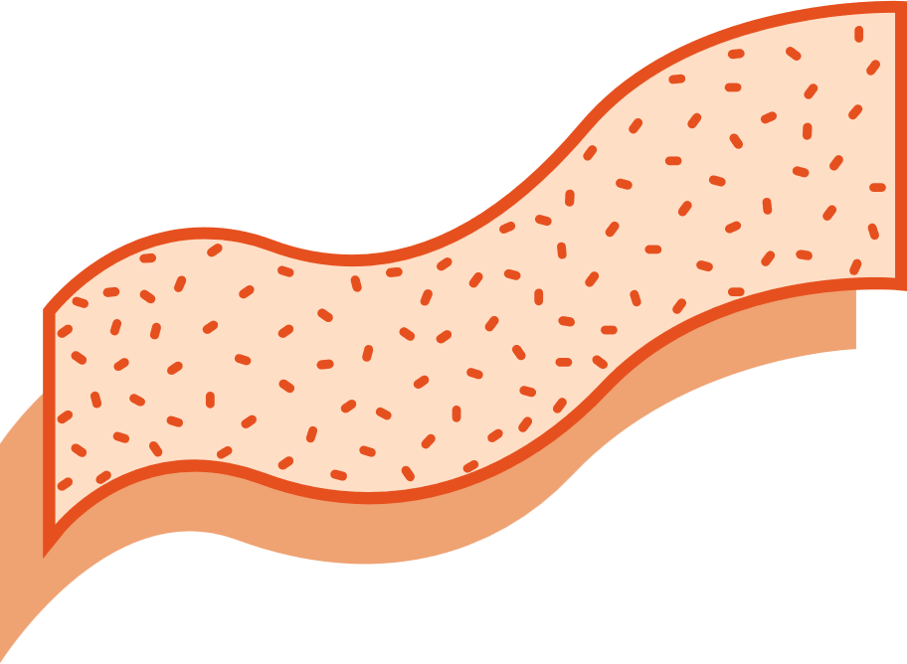



uSpark Application
MVP
HOSPITAL RECOMMENDATIONS
BOOK APPOINTMENTS!!
Users can now see recommendations of hospitals that might be suitable for their issue. These recommendations on their assessment done via a series of questions asked by our chatbot “Uheal”
Distance from Hospital, working hours can be seen.
uSpark allows users to make appointments which can be in-person or virtual based on their availability and doctor’s availability , in contrast to the traditional way of making appointments
ONE CARD
uHeal stores the details of the health issue of the patient which is obtained from the conducted assessment, all the assessment details are saved on ONE CARD along with the date of assessment. One card involves patient’s assessment details, insurance details, personal details and a QR code that is used to share the ONE CARD, this completely eliminates the need for physical documents to store information.
CHATBOT – Uheal
uHeal conducts an assessment for the patients with the help of a series of questions, and also gives a few preventive measures and It also makes appointments for the user by giving recommendations about hospitals, in contrast to the traditional method of searching hospitals
Useg
Useg is an ML algorithm that is used by doctors as a part of their diagnosis.
This makes their work easier and helps them to narrow down the issue in a much quicker way

Slide 15
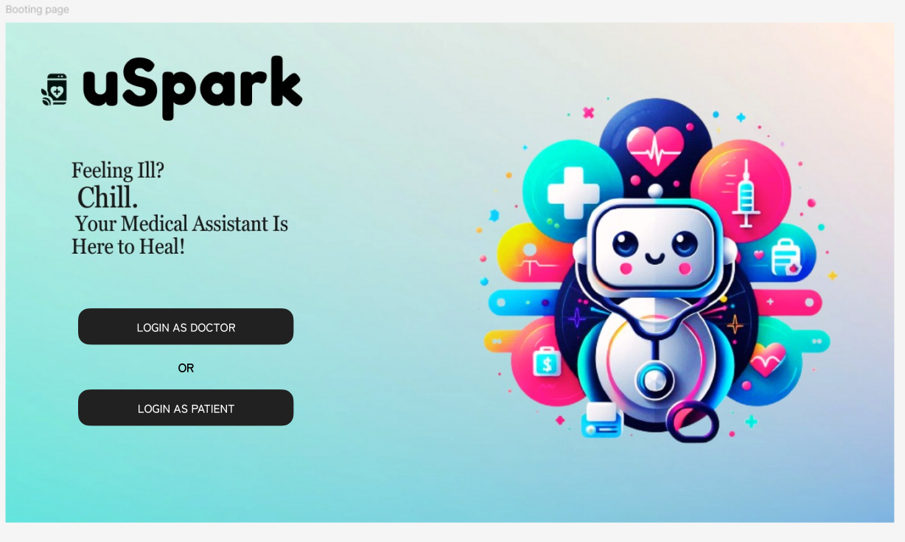
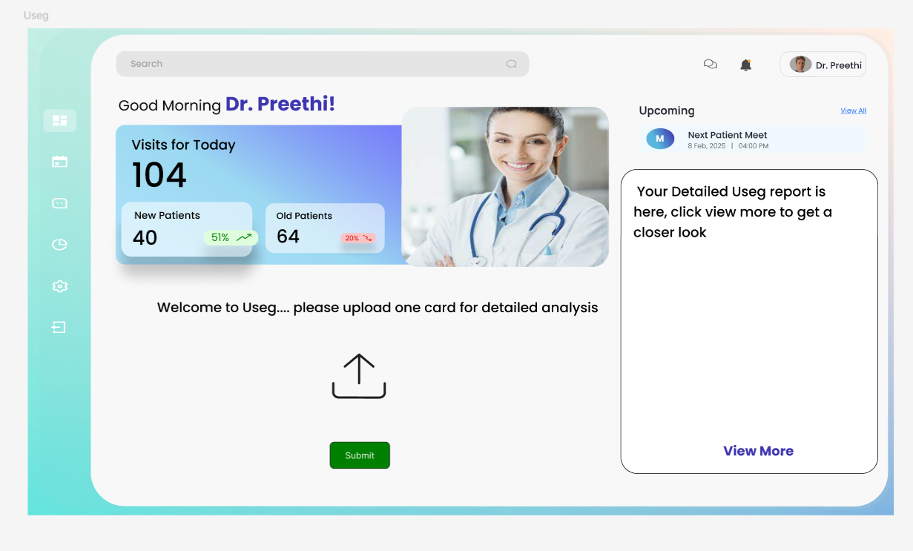
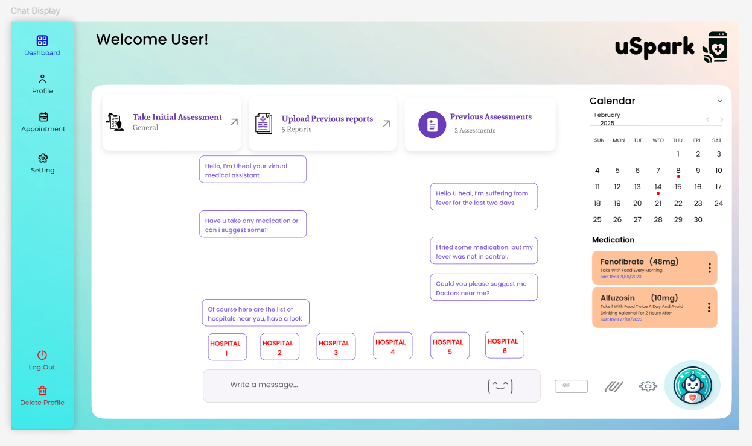
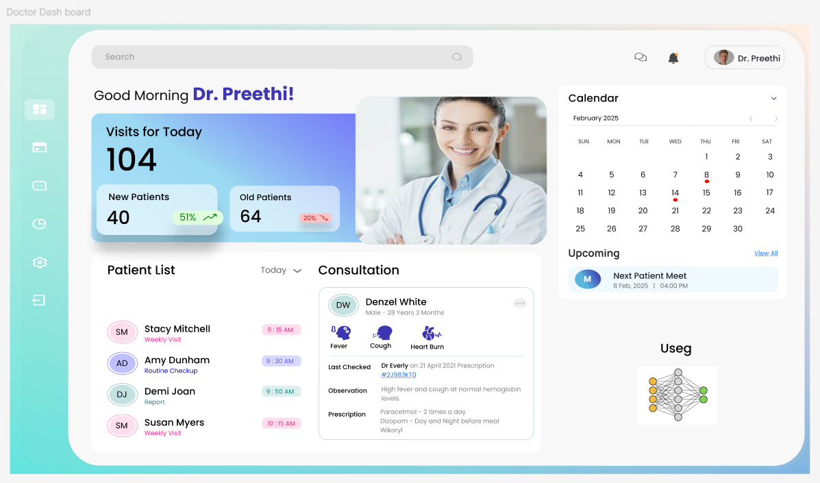
Product Design

Slide 16
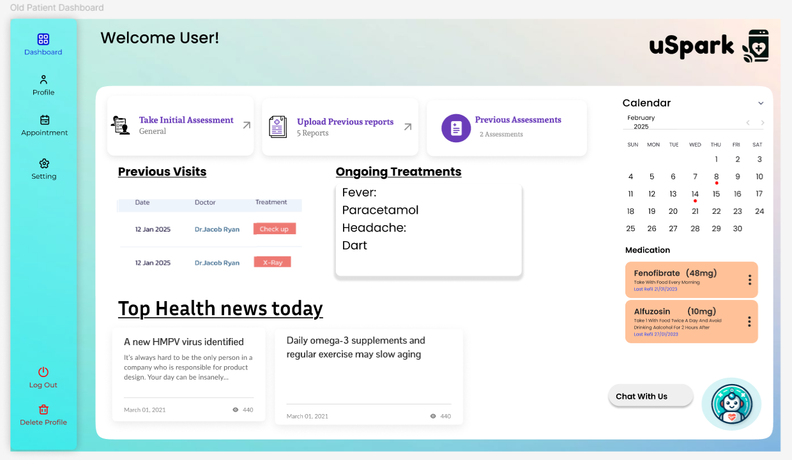
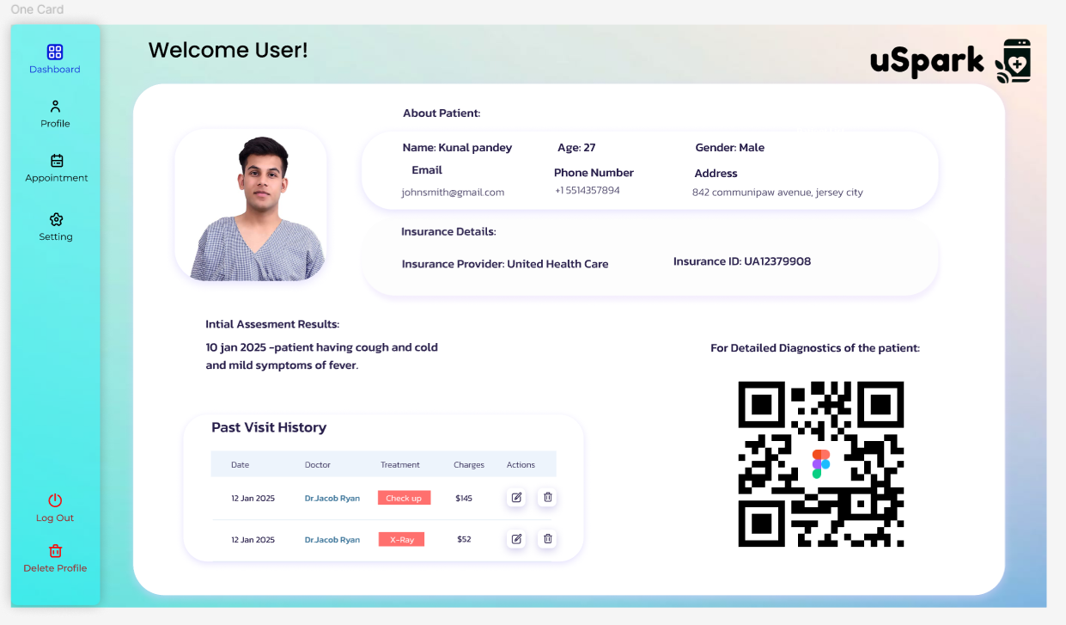
MVP Design

Slide 17






Technologies and Tools
Full Stack /ML AI Programming Languages
Node JS
React
Python
Node.js – JavaScript runtime used to build the backend services (server-side logic).
React.js – JavaScript library for building dynamic, responsive frontends.
Redux – Helps manage application-wide state in React smoothly.
Axios – Used for making API requests between frontend and backend.
Material UI – React-based UI toolkit for building visually appealing user interfaces.
Python – Main language for AI/ML development and backend scripting.
Redux
Axios
Material UI

Slide 18







Technologies and Tools
Libraries, Algorithms and Frameworks, Database
Mongo DB
Amazon S3
MongoDB – NoSQL database for storing flexible healthcare records like assessments and profiles.
Amazon S3 (AWS) – Cloud storage used for securely storing medical files, images, and reports.
Faiss Vector DB – Specialized database used in AI for similarity search and fast retrieval (helpful in hospital recommendations).
TensorFlow – ML framework used to build and train models like image processors.
PyTorch – Another flexible ML library used for model experimentation.
Flask – A Lightweight web framework to serve ML models via APIs.
Faiss Vector Database
MERN Stack
Pytorch
TensorFlow
Flask

Slide 19


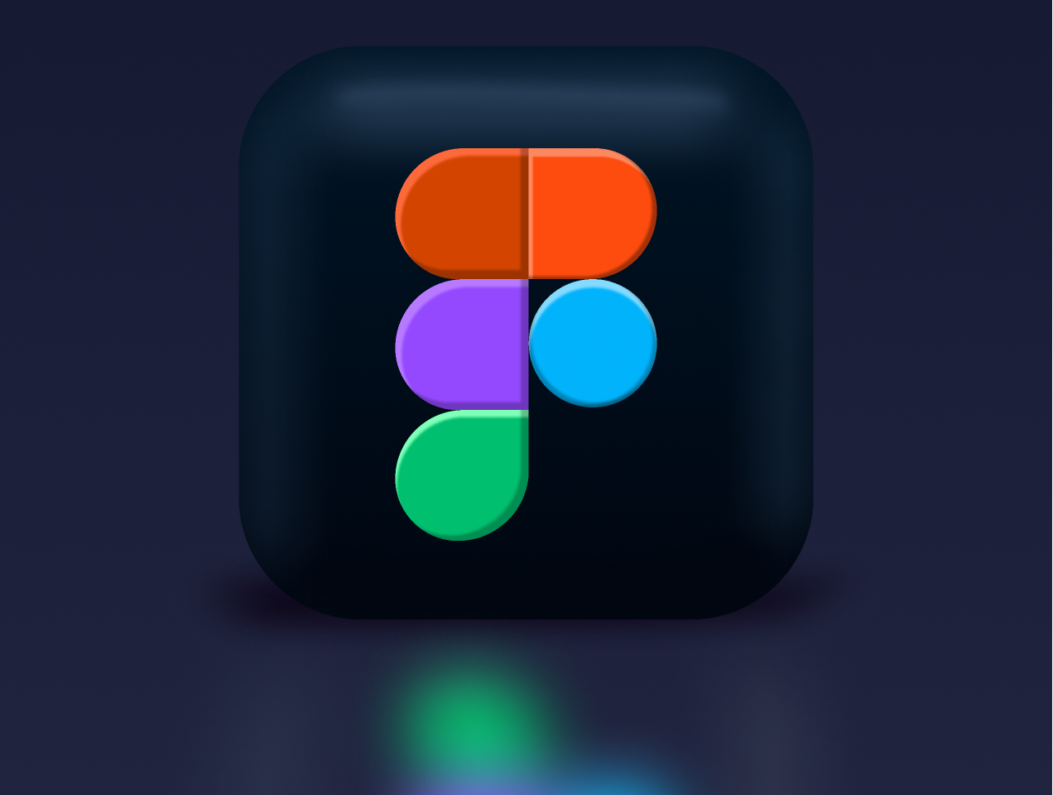



Technologies and Tools
Tools
Jira
Docker
Docker – Used to containerize applications for consistent deployment across environments.
VS Code – Code editor for development with built-in Git and extension support.
GitHub – Version control and collaboration platform for code.
Postman – Tool for testing and verifying API functionality during development.
Figma – Tool for designing UI/UX prototypes collaboratively.
Jira – Agile tool for managing sprints, tasks, and team workflow.
Figma
VS code
Postman
GitHub

Slide 20
Algorithms And Models:
RAG (Retrieval-Augmented Generation): Combines document retrieval with text generation to provide accurate, knowledge-based responses—used in our chatbot to give more informed medical answers.
DenseNet (Densely Connected Convolutional Network): A deep learning model that strengthens feature reuse and reduces computation, used for analyzing biomedical images efficiently.
ResNet (Residual Neural Network): A powerful model designed to solve vanishing gradient issues helps improve the accuracy of medical image diagnosis.
DialoGPT: A conversational AI model trained for dialogue generation—used to make our chatbot (Uheal) interactive and human-like in communication.

Slide 21
Diagrams

Slide 22
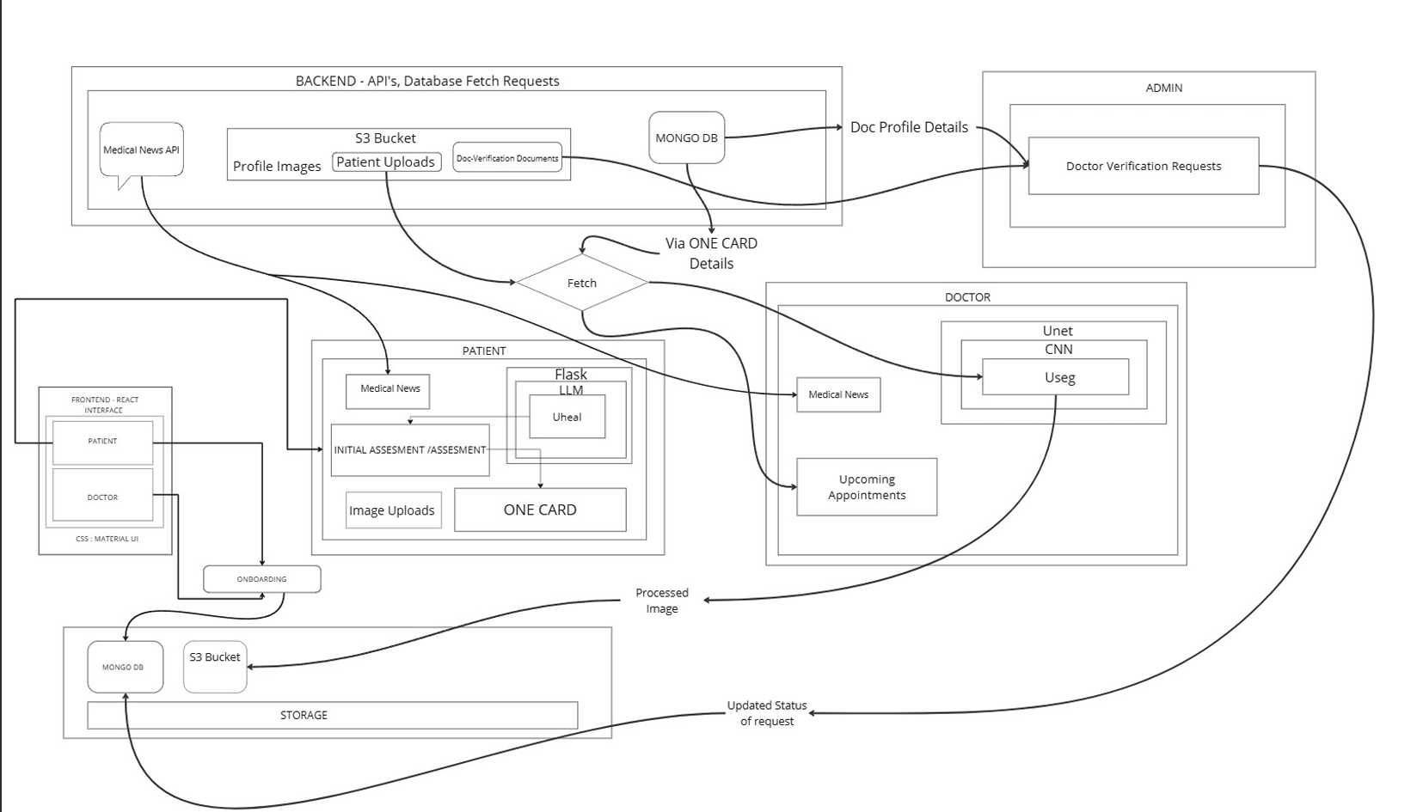
Architecture Diagram

Slide 23
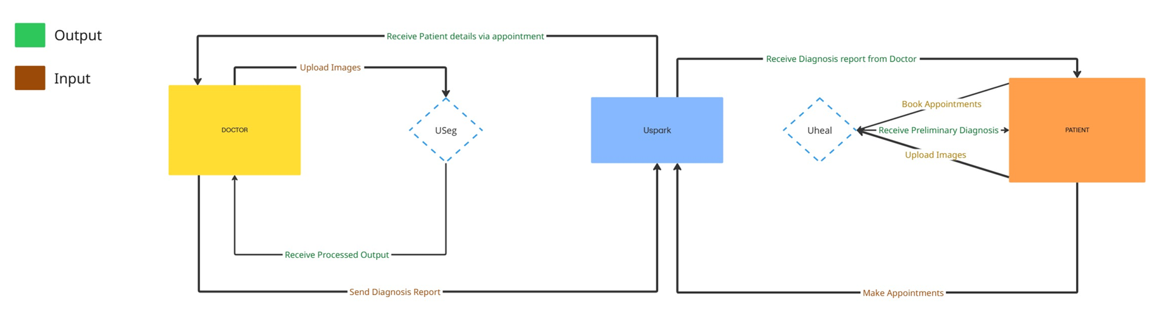
Context Diagram

Slide 24
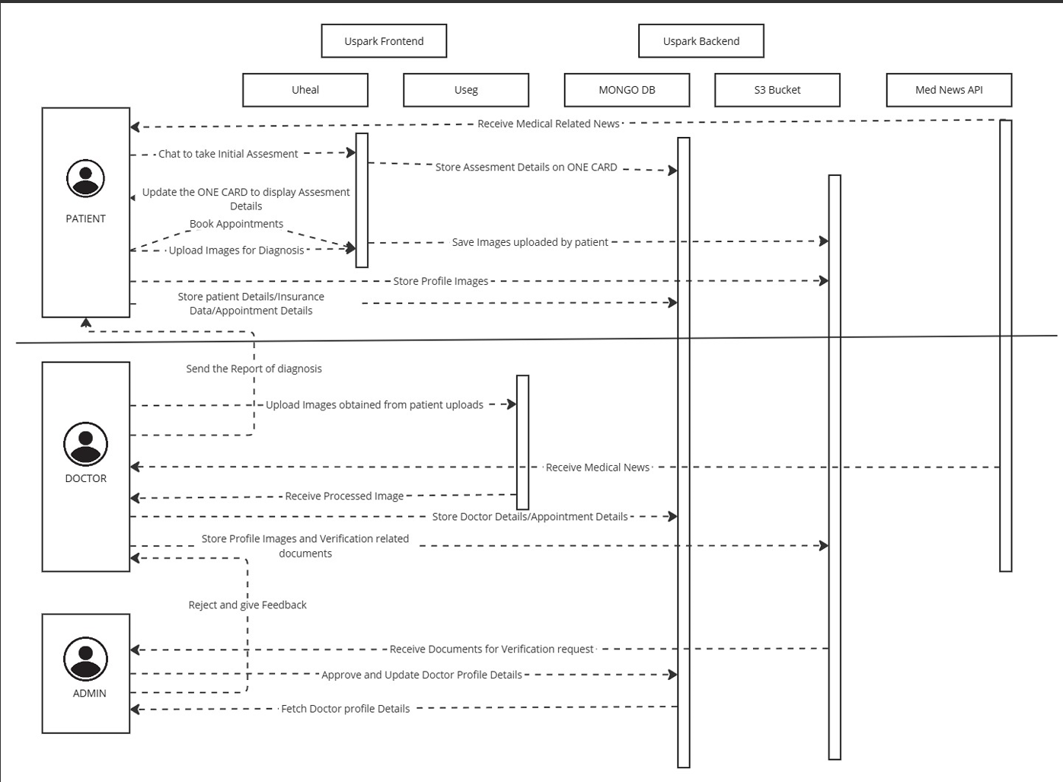
Sequence Diagram

Slide 25
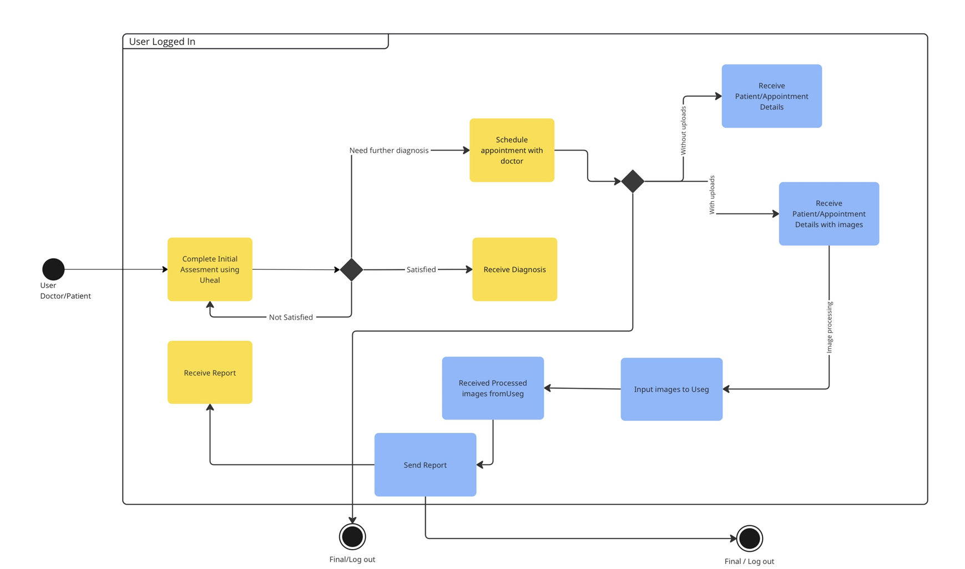
State Diagram

Slide 26
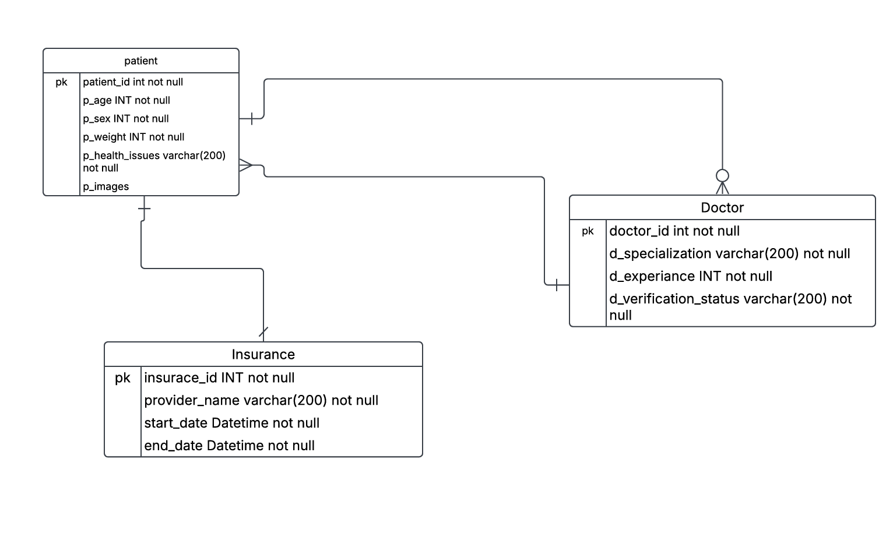
Class Diagram

Slide 27
Sprint 1 Recap:
In Sprint 1, we focused on building the foundation of our application by enabling key functionalities for patients, doctors, and admins. The following features were successfully implemented:
Sign-up via email, phone, or social media, and successful login post-registration.
Patient Profile Management: Patients can create and update their personal and insurance details.
Doctors can register and submit credentials for verification.
Integration of AI-generated heatmaps and segmentation for enhanced diagnostic visuals.
Admins can review and verify doctor credentials, approving or rejecting them.
Doctors can log in and access their profile and dashboard after approval.
31 Story Points
Completed 100% of the Story Points

Slide 28
Product Backlog
S.NO | USER STORIES | ACCEPTANCE CRITERIA | STORY POINTS
US_23 | As a doctor, I want to get heat maps and segmented outputs for easier diagnosis. | Doctor receives a list of potential diagnoses based on patient data. | 8
US_27 | As an admin, my dashboard needs access by me only not by others for security purposes. | Admin dashboard is secured with role-based access control and audit logs. | 5
US_12 | As a patient, I want to see ratings and reviews for doctors before booking an appointment | Patient can view average ratings and user reviews for each listed doctor. | 5
US_26 | As an admin, I want to manage and verify doctors’ credentials before they are approved. | Admin can view, verify, and approve doctor credentials via dashboard. | 5
US_24 | As a doctor, I want to get potential diagnoses based on biomedical images. | Doctor receives a list of potential diagnoses based on patient data. | 5
US_22 | As a doctor, I want to upload medical images (X-rays, MRIs, CT scans) for AI processing. | Doctor can upload and review medical images linked to a patient. | 5
US_18 | As a doctor, I want to register and submit my credentials for verification. | Doctor can submit credentials and profile information for verification. | 5
US_17 | As a patient, I want to link my health insurance to cover consultation charges. | Patient can link valid insurance information to be used during billing. | 5

Slide 29
Product Backlog
S.NO | USER STORIES | ACCEPTANCE CRITERIA | STORY POINTS
US_15 | As a patient, I want to join a video call for virtual consultations | Patient can join secure video calls at scheduled consultation time. | 5
US_21 | As a doctor, I want to manage my patients' health records and notes. | Doctor can write or update notes in their profile, and the system will save the information securely. | 3
US_13 | As a patient, I want to receive a preliminary diagnosis from application based on my symptoms. | Chatbot provides preliminary diagnosis based on patient's symptom inputs. | 3
US_1 | As a patient, I want to sign up using email, phone, or social media so that I can access the application. | Patient can sign up using email, or social media with validation and secure transmission. | 3
US_11 | As a patient, I want to search for doctors based on specialty, availability, and location. | Patient can search for doctors using filters like specialization and rating. | 3
US_8 | As a patient, I want to choose between virtual or in-person appointments. | Patient can choose virtual or in-person consultation during appointment booking. | 3
US_6 | As a patient, I want to share my medical history with doctors for better diagnosis. | Patient can share selected medical records with doctors before or during appointments. | 3
US_5 | As a patient, I want to store my past medical assessments and reports for future reference. | Patient can upload medical files and view/download them later securely. | 3

Slide 30
Product Backlog
S.NO | USER STORIES | ACCEPTANCE CRITERIA | STORY POINTS
US_4 | As a patient, I want to view my past appointments and prescriptions in my profile. | Patient can view historical appointments and prescriptions from profile. | 3
US_3 | As a patient, I want to create and update my profile with personal details, and insurance information. | Patient can create and update personal profile with validated fields. | 3
US_14 | As a patient, I want suggestions whether I need an in-person visit, virtual consultation, or self-care. | AI engine suggests whether doctor consultation is needed based on symptoms. | 3
US_2 | As a patient, I want to reset my password in case I forget it. | Patient can reset password via email link after identity verification. | 2
US_9 | As a patient, I want to receive appointment confirmation via email or SMS. | Appointment confirmation via email/sms via uheal. | 2
US_19 | As a doctor, I want to login to my profile, and view my details | Doctor can log in, update profile, and manage security settings. | 2
US_20 | As a doctor, I want to see a list of my upcoming and past appointments. | Doctor sees dashboard listing upcoming appointments by date/time. | 2
US_7 | As a patient, I want to schedule an appointment with a doctor based on available time slots. | Patient can select doctor, date, and time to schedule an appointment with confirmation. | 2

Slide 31
Product Backlog
S.NO | USER STORIES | ACCEPTANCE CRITERIA | STORY POINTS
US_10 | As a patient, I want to reschedule or cancel an appointment. | Patient can reschedule or cancel an appointment with confirmation and reason. | 1
US_16 | As a patient, I want recommend doctors based on my condition. | Patient can enter their symptoms, and the system will use AI to suggest the best doctor. | 1
US_25 | As a doctor, I want to receive notifications when a patient books or cancels an appointment. | Doctor is notified of upcoming, missed, or rescheduled appointments. | 1

Slide 32
SPRINT 2 STORIES
S.NO | USER STORIES | ACCEPTANCE CRITERIA | FEATURE | STORY POINTS
US_02 | As a patient, I want to reset my password in case I forget it. | Patient can reset password via email link after identity verification. | Password reset functionality | 2
US_03 | As a patient, I want to create and update my profile with personal details, medical history, and insurance information. | Patient can create and update personal profile with validated fields. | Patient profile management | 3
US_05 | As a patient, I want to store my past medical assessments and reports for future reference. | Patient can upload medical files and view/download them later securely. | Share medical history with doctors | 3
US_06 | As a patient, I want to share my medical history with doctors for a better diagnosis. | Patient can share selected medical records with doctors before or during appointments. | Appointment scheduling via Uheal. | 3
US_07 | As a patient, I want to schedule an appointment with a doctor based on available time slots. | Patient can select doctor, date, and time to schedule an appointment with confirmation. | Appointment scheduling via Uheal. | 2
US_08 | As a patient, I want to choose between virtual or in-person appointments. | Patient can choose virtual or in-person consultation during appointment booking. | Choose virtual or in-person consultation via Uheal. | 3

Slide 33
SPRINT 2 STORIES
S.NO | USER STORIES | ACCEPTANCE CRITERIA | FEATURE | STORY POINTS
US_09 | As a patient, I want to receive appointment confirmation via email or SMS. | Appointment confirmation via email/sms via uheal. | Appointment confirmation via email/SMS via Uheal. | 2
US_10 | As a patient, I want to reschedule or cancel an appointment. | Patient can reschedule or cancel an appointment with confirmation and reason. | Reschedule or cancel appointments via Uheal. | 1
US_13 | As a patient, I want to receive a preliminary diagnosis from application based on my symptoms. | System provides preliminary diagnosis based on patient's symptom inputs. | AI-based preliminary diagnosis via Uheal. | 3
US_16 | As a patient, I want recommend doctors based on my condition. | Patient can enter their symptoms, and the system will use AI to suggest the best doctor. | AI doctor recommendations based on condition. | 1
US_19 | As a doctor, I want to manage my profile, including my specialty, availability, and appointment preferences. | Doctor can log in, update profile, and manage security settings. | Doctor profile management | 2
US_20 | As a doctor, I want to see a list of my upcoming and past appointments. | Doctor sees dashboard listing upcoming appointments by date/time. | Appointment Scheduling | 2

Slide 34
SPRINT 2 STORIES
S.NO | USER STORIES | ACCEPTANCE CRITERIA | FEATURE | STORY POINTS
US_21 | As a doctor, I want to manage my patients' health records and notes. | Doctor can write or update notes in their profile, and the system will save the information securely. | Manage patient health records and notes can be done with one card | 3
US_22 | As a doctor, I want to upload medical images (X-rays, MRIs, CT scans) for AI processing. | Doctor can upload and review medical images linked to a patient. | Upload medical images (X-rays, MRIs, CT scans) for AI processing via Useg. | 5
US_25 | As a doctor, I want to receive notifications when a patient books or cancels an appointment. | Doctor is notified of upcoming, missed, or rescheduled appointments. | Receive notifications for appointments | 1

Slide 35
SPRINT 2 TEST CASES
US_ID | TC_ID | Test Case | Steps | Execution Status | Result
US_02 | TC_21 | Request Password Reset Link | Forgot Password page -->Enter email Click 'Send Reset Link' button->Observe the success message | Success message 'Password reset email sent' should be visible in green. | Pass
US_02 | TC_22 | Reset Password Using Token | Visit the Reset Password page with a email Enter a new password and confirm password Click the Submit button | Password should be reset successfully. | Pass
US_03 | TC_23 | Complete Onboarding + Profile Update | Go to signup page → fill details->Select role as Patient. Fill onboarding form -->submit Go to Profile page-->Upload profile image Update Details Add insurance info | Profile and insurance info is updated successfully. Uploaded image is visible. | Pass
US_21 | TC_24 | View patient health records | Login as doctor Navigate to "My Patients“ Click on "Manage" for any patient | Doctor is not able to see patient's full health history | Fail
US_21 | TC_25 | View patient health records | Login as doctor Navigate to "My Patients“ Click on "Manage" for any patient | Doctor should see patient's full health history | Pass

Slide 36
SPRINT 2 TEST CASES
US_ID | TC_ID | Test Case | Steps | Execution Status | Result
US_07 | TC_26 | Schedule an appointment with a doctor | Visit signup page--> Fill signup form-->Click signup Select patient role-->Fill onboarding details--> Submit onboarding Visit appointment page--> Search doctor-->Click 'Book’ Fill details-->Select date-->Pick time slot->Confirm-->Verify" | The appointment’s date/time is updated and displayed correctly | pass
US_9 | TC_27 | Book an appointment as a patient and verify confirmation | Sign up as a new patient-->Complete onboarding Go to dashboard-->Search and select a doctor Fill appointment form and submit | Appointment is booked and shown under 'Your Appointments'. Email/SMS confirmation is triggered. | Pass
US_10 | TC_28 | Reschedule an existing appointment | Sign up & complete onboarding as a patient Book a new appointment--> Visit the Appointments page Click the “Edit” (✎) button on that appointment Change the date and/or time slot-->Click “Save” Observe the updated appointment details in the list | The Appointment doesn’t get rescheduled | Fail

Slide 37
SPRINT 2 TEST CASES
US_ID | TC_ID | Test Case | Steps | Execution Status | Result
US_10 | TC_29 | Reschedule an existing appointment | Sign up & complete onboarding as a patient Book a new appointment--> Visit the Appointments page Click the “Edit” (✎) button on that appointment Change the date and/or time slot-->Click “Save” Observe the updated appointment details in the list | The appointment’s date/time is updated and displayed correctly | Pass
US_10 | TC_30 | Cancel an existing appointment | Sign up & complete onboarding as a patient Book a new appointment--> Visit the Appointments page Click the “Edit” (✎) button on that appointment-->Click “Cancel Appointment” Confirm the cancellation in the dialog Refresh or revisit the page | The appointment is removed from the list | Pass
US_16 | TC_31 | Recommend doctors to patients based on their condition | Patient logs into the application-->Patient selects or inputs their health condition. System suggests a list of doctors specializing in that condition. Patient views doctor profiles and optionally books an appointment. | Patient is shown a list of recommended doctors relevant to the condition provided. | Pass

Slide 38
SPRINT 2 TEST CASES
US_ID | TC_ID | Test Case | Steps | Execution Status | Result
US_06 | TC_32 | Add medical history | Log in as a patient Navigate to profile or medical history section Click "Add History“ Enter health issue, treatment, status Save | Medical history is saved and visible in the patient's profile | Pass
US_20 | TC_33 | Sign up as doctor and verify booked appointments are shown | Sign up as a new doctor--> Complete onboarding Navigate to Doctor Dashboard--> View availability calendar and select date Click on booked time slot | Booked appointments are displayed correctly with patient details in a dialog. | Pass
US_25 | TC_34 | Verify doctor receives notification on patient appointment booking/cancellation | Log in as a doctor-->Patient logs in and books an appointment with this doctor Doctor checks for notification Patient cancels the appointment-->Doctor checks for cancellation notification | Doctor receives notifications when appointment is booked and when it is cancelled. | Pass
US_19 | TC_30 | Manage doctor profile (specialty, availability, preferences) | Visit signup page--> Fill signup form-->Click signup Select Doctor role-->Fill onboarding details--> Submit onboarding Visit profile page-->Upload profile image-->Update details Save profile-->Upload verification document-->Confirm upload" | Profile image updated, details saved correctly, and verification document uploaded successfully | Pass

Slide 39
SPRINT 2 STORIES COMPLETED
USER ID | USER STORIES | ACCEPTANCE CRITERIA | FEATURE | STORY POINTS
US_02 | As a patient, I want to reset my password in case I forget it. | Patient can reset password via email link after identity verification. | Password reset functionality | 2
US_03 | As a patient, I want to create and update my profile with personal details, medical history, and insurance information. | Patient can create and update personal profile with validated fields. | Patient profile management | 3
US_6 | As a patient, I want to share my medical history with doctors for better diagnosis. | Patient can share selected medical records with doctors before or during appointments. | Share medical history with doctors | 3
US_7 | As a patient, I want to schedule an appointment with a doctor based on available time slots. | Patient can select doctor, date, and time to schedule an appointment with confirmation. | Appointment scheduling via Uheal. | 2
US_9 | As a patient, I want to receive appointment confirmation via email or SMS. | Appointment confirmation via email/sms via uheal. | Appointment confirmation via email/SMS via Uheal. | 2
US_10 | As a patient, I want to reschedule or cancel an appointment. | Patient can reschedule or cancel an appointment with confirmation and reason. | Reschedule or cancel appointments via Uheal. | 1

Slide 40
SPRINT 2 STORIES COMPLETED
S.NO | USER STORIES | ACCEPTANCE CRITERIA | FEATURE | STORY POINTS
US_16 | As a patient, I want recommend doctors based on my condition. | Patient can enter their symptoms, and the system will use AI to suggest the best doctor. | AI doctor recommendations based on condition. | 1
US_19 | As a doctor, I want to manage my profile, including my specialty, availability, and appointment preferences. | Doctor can log in, update profile, and manage security settings. | Doctor profile management | 2
US_20 | As a doctor, I want to see a list of my upcoming and past appointments. | Doctor sees dashboard listing upcoming appointments by date/time. | Appointment Scheduling | 2
US_21 | As a doctor, I want to manage my patients' health records and notes. | Doctor can write or update notes in their profile, and the system will save the information securely. . | Manage patient health records and notes can be done with one card | 3
US_25 | As a doctor, I want to receive notifications when a patient books or cancels an appointment. | Doctor is notified of upcoming, missed, or rescheduled appointments. | Receive notifications for appointments | 1

Slide 41
SPRINT 2 STORIES NOT COMPLETED
S.NO | USER STORIES | ACCEPTANCE CRITERIA | FEATURE | STORY POINTS | Completed Points
US_5 | As a patient, I want to store my past medical assessments and reports for future reference. | Patient can upload medical files and view/download them later securely. | Upload & store medical assessments and reports | 3 | 1
US_8 | As a patient, I want to choose between virtual or in-person appointments. | Patient can choose virtual or in-person consultation during appointment booking. | Choose virtual or in-person consultation via Uheal. | 3 | 1
US_13 | As a patient, I want to receive a preliminary diagnosis from application based on my symptoms. | System provides preliminary diagnosis based on patient's symptom inputs. | AI-based preliminary diagnosis via Uheal. | 5 | 3
US_22 | As a doctor, I want to upload medical images (X-rays, MRIs, CT scans) for AI processing. | Doctor can upload and review medical images linked to a patient. | Upload medical images (X-rays, MRIs, CT scans) for AI processing via Useg. | 3 | 2

Slide 42
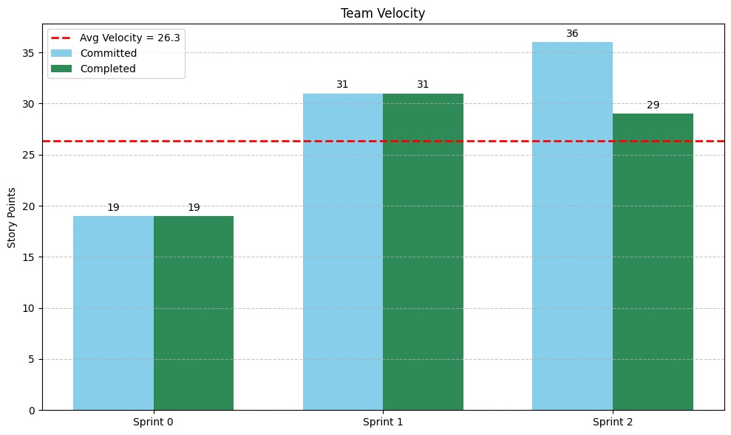
Sprint Velocity:

Slide 43
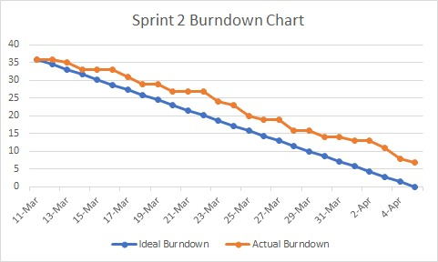
METRICS - BURNDOWN CHART

Slide 44
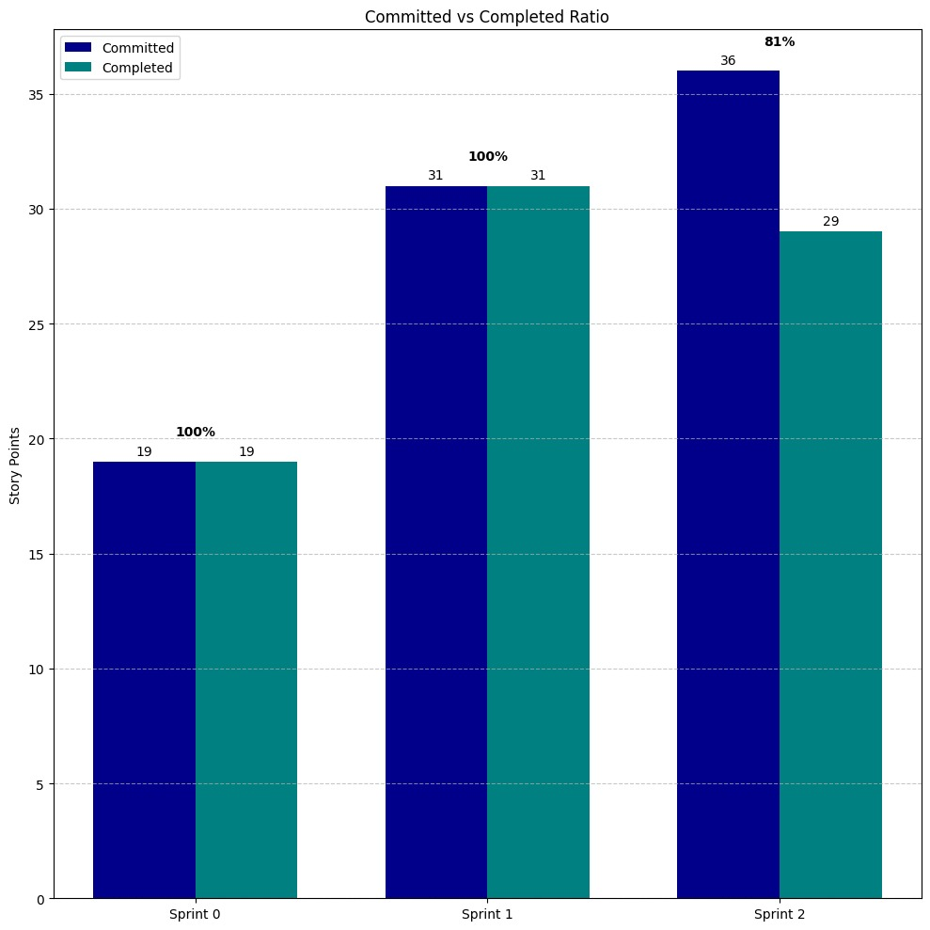
METRICS - COMMITTED RATIO

Slide 45
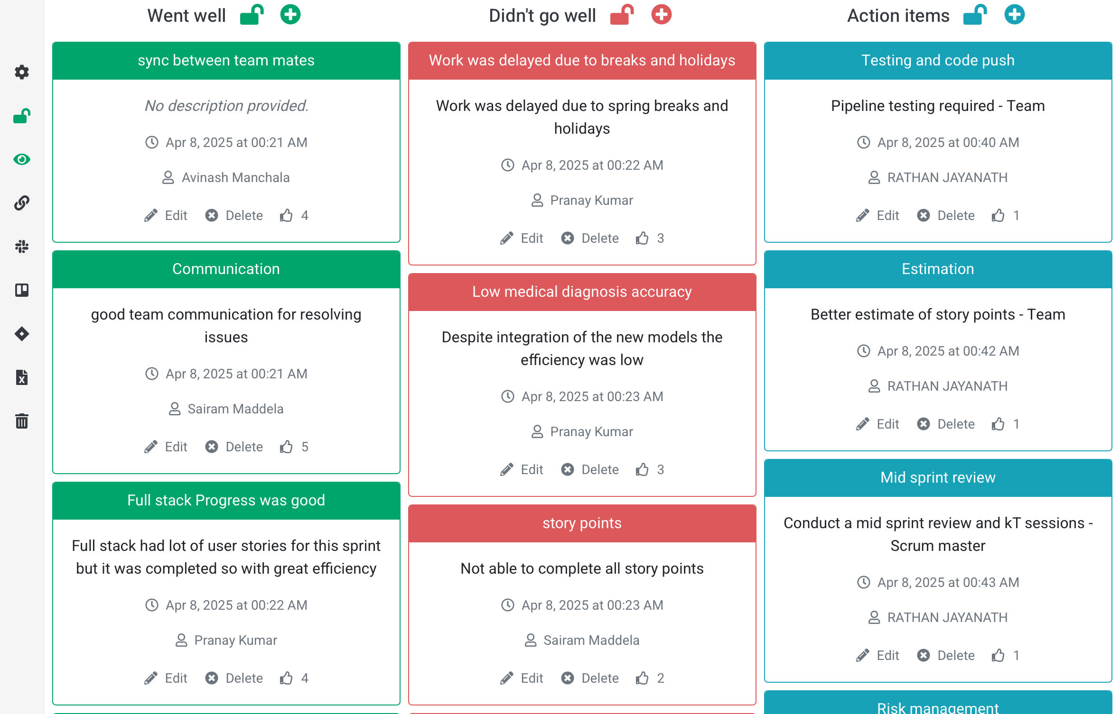
Sprint Retrospective

Slide 46
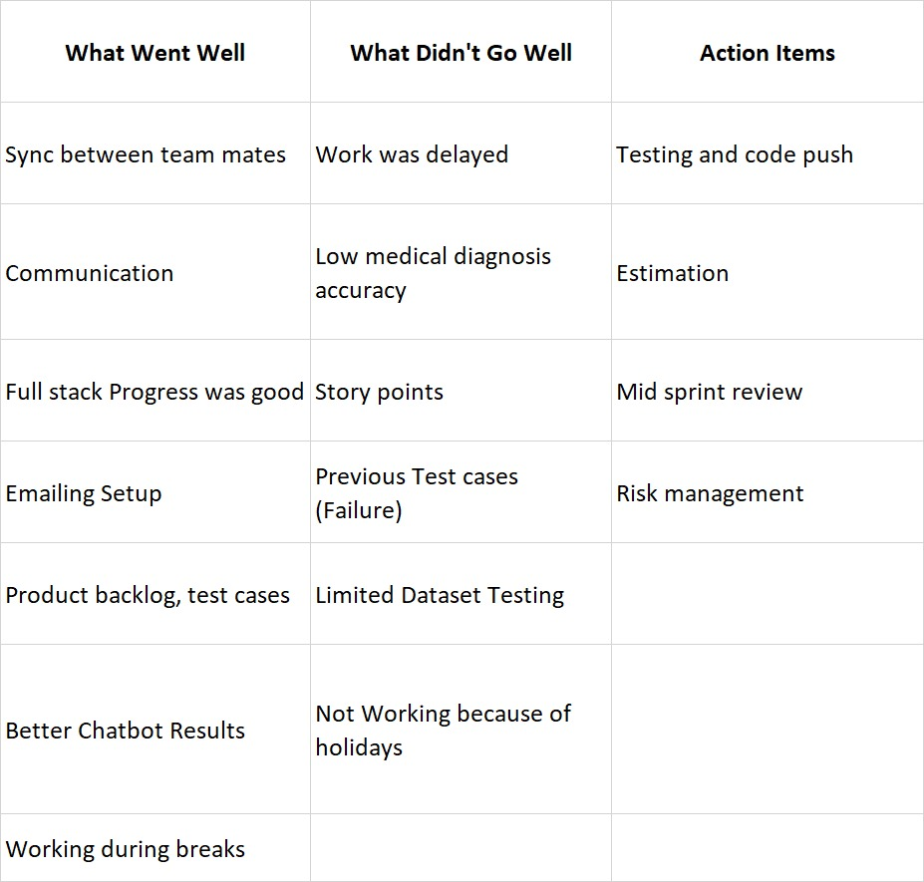
Sprint Retrospective

Slide 47
Sprint 3 Planning:
S.NO | USER STORIES | ACCEPTANCE CRITERIA | FEATURE | STORY POINTS
US_4 | As a patient, I want to view my past appointments and prescriptions in my profile. | Patient can view historical appointments and prescriptions from profile. | View past appointments & prescriptions | 3
US_11 | As a patient, I want to search for doctors based on specialty, availability, and location. | Patient can search for doctors using filters like specialization and rating. | Search doctors based on specialty, availability, and location via Uheal. | 3
US_12 | As a patient, I want to see ratings and reviews for doctors before booking an appointment | Patient can view average ratings and user reviews for each listed doctor. | View doctor ratings and reviews via Uheal. | 5
US_14 | As a patient, I want suggestions whether I need an in-person visit, virtual consultation, or self-care. | AI engine suggests whether doctor consultation is needed based on symptoms. | AI-based consultation suggestions via Uheal. | 3
US_15 | As a patient, I want to join a video call for virtual consultations | Patient can join secure video calls at scheduled consultation time. | Video call for virtual consultations via Uheal. | 5
US_24 | As a doctor, I want to get potential diagnoses based on biomedical images. | Doctor receives a list of potential diagnoses based on patient data. | Receive notifications for appointments | 5

Slide 48
Sprint 3 Planning:
S.NO | USER STORIES | ACCEPTANCE CRITERIA | FEATURE | STORY POINTS
US_5 | As a patient, I want to store my past medical assessments and reports for future reference. | Patient can upload medical files and view/download them later securely. | Upload & store medical assessments and reports | 2
US_8 | As a patient, I want to choose between virtual or in-person appointments. | Patient can choose virtual or in-person consultation during appointment booking. | Choose virtual or in-person consultation via Uheal. | 2
US_13 | As a patient, I want to receive a preliminary diagnosis from application based on my symptoms. | System provides preliminary diagnosis based on patient's symptom inputs. | AI-based preliminary diagnosis via Uheal. | 2
US_22 | As a doctor, I want to upload medical images (X-rays, MRIs, CT scans) for AI processing. | Doctor can upload and review medical images linked to a patient. | Upload medical images (X-rays, MRIs, CT scans) for AI processing via Useg. | 1

Slide 49
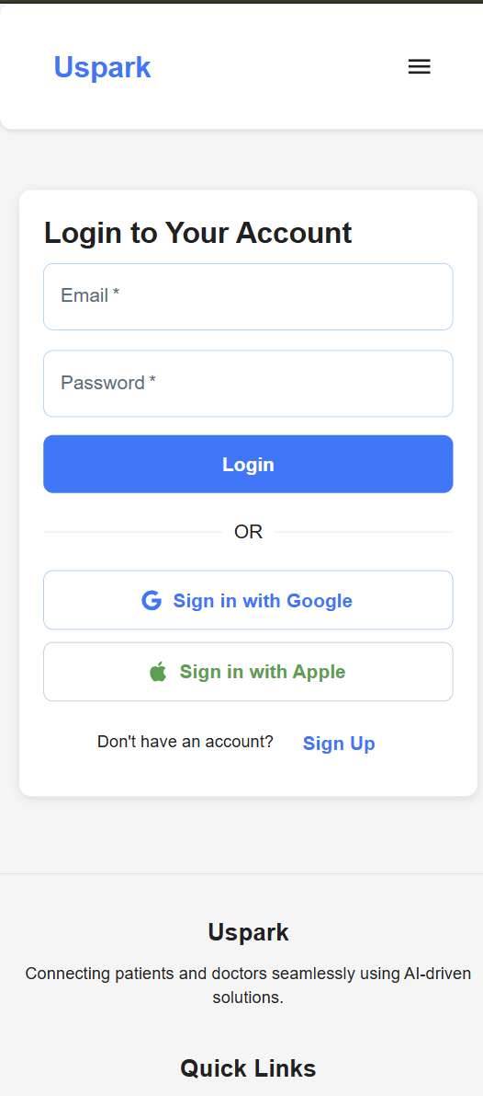
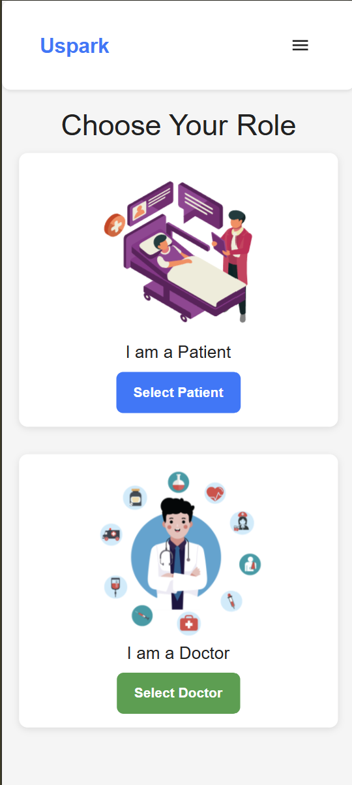
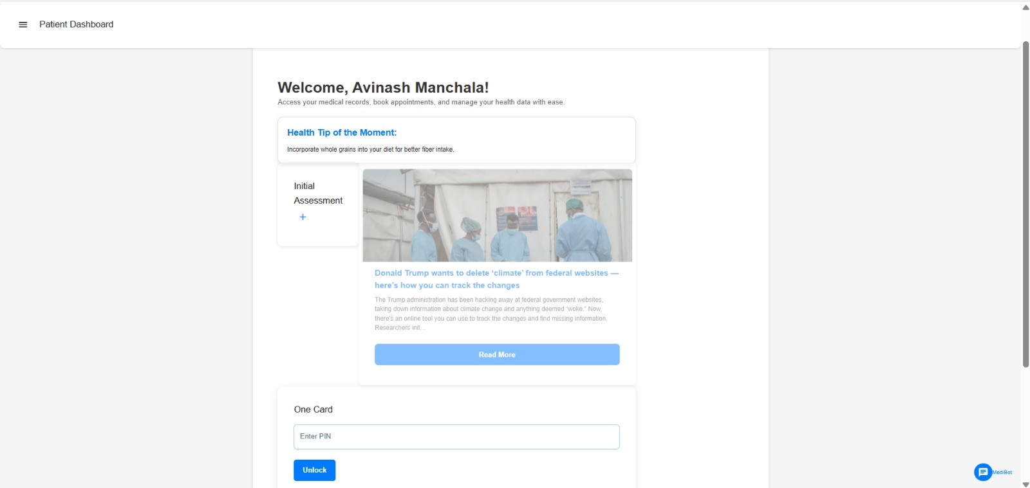
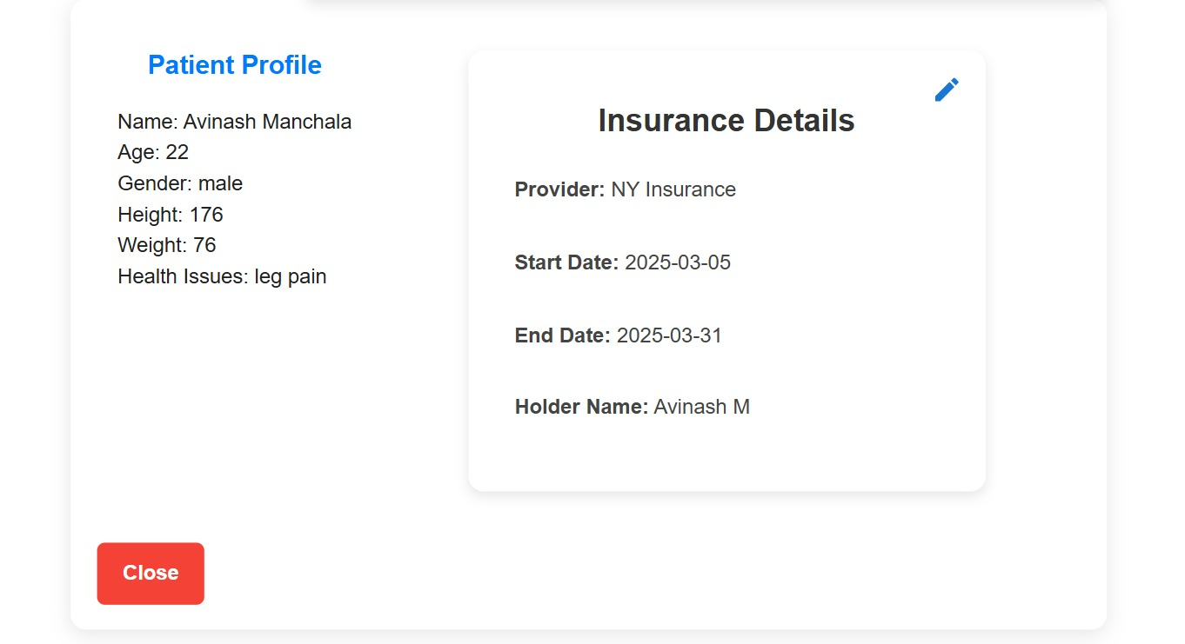
Project Demo

Slide 50
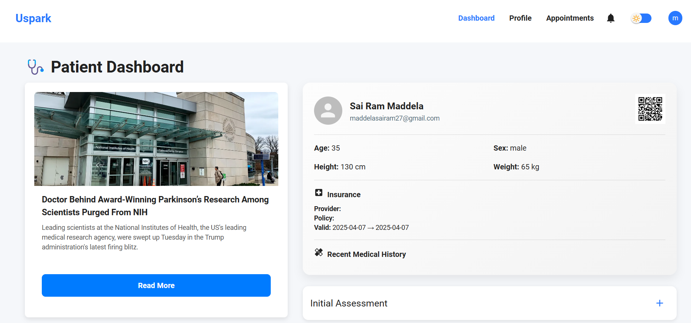
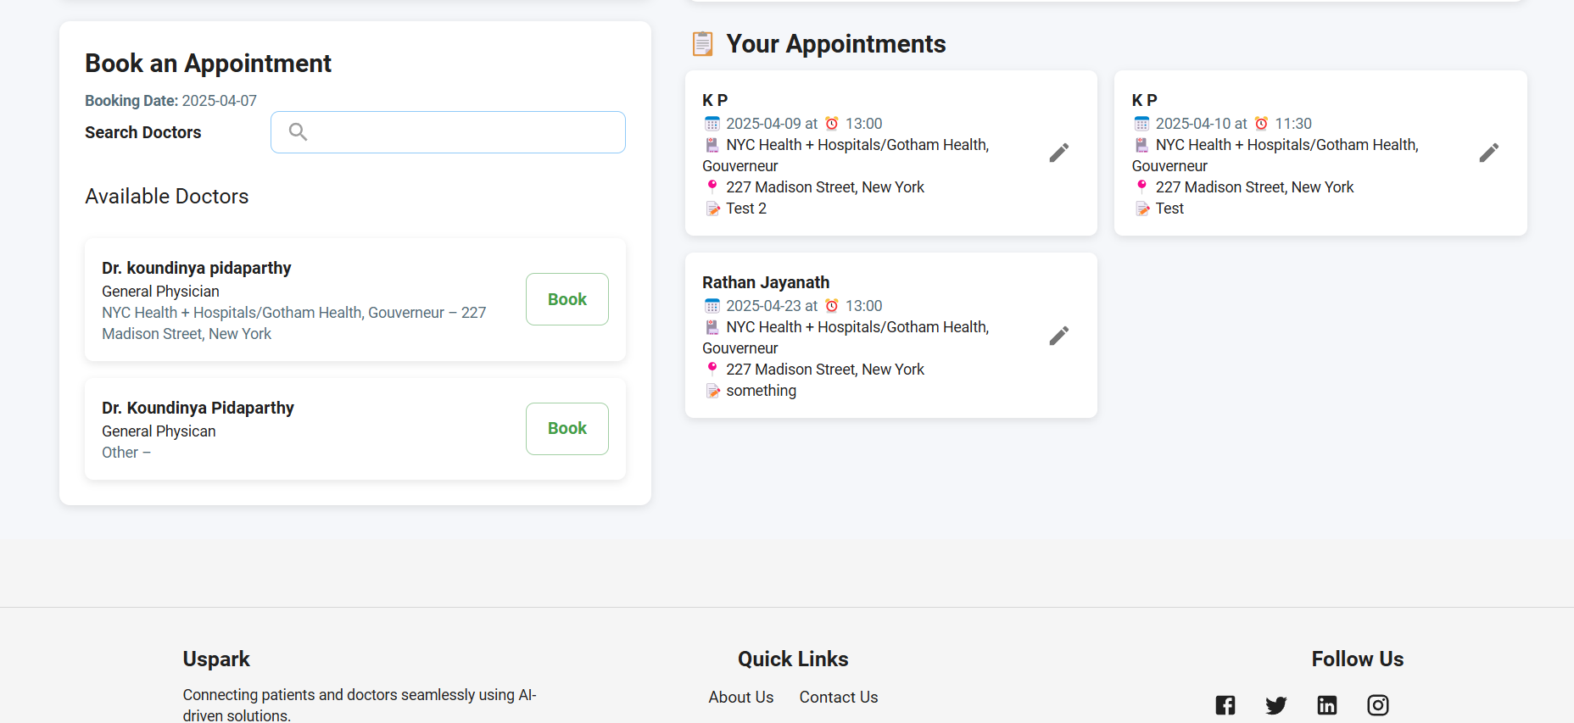
Application Screenshots

Slide 51
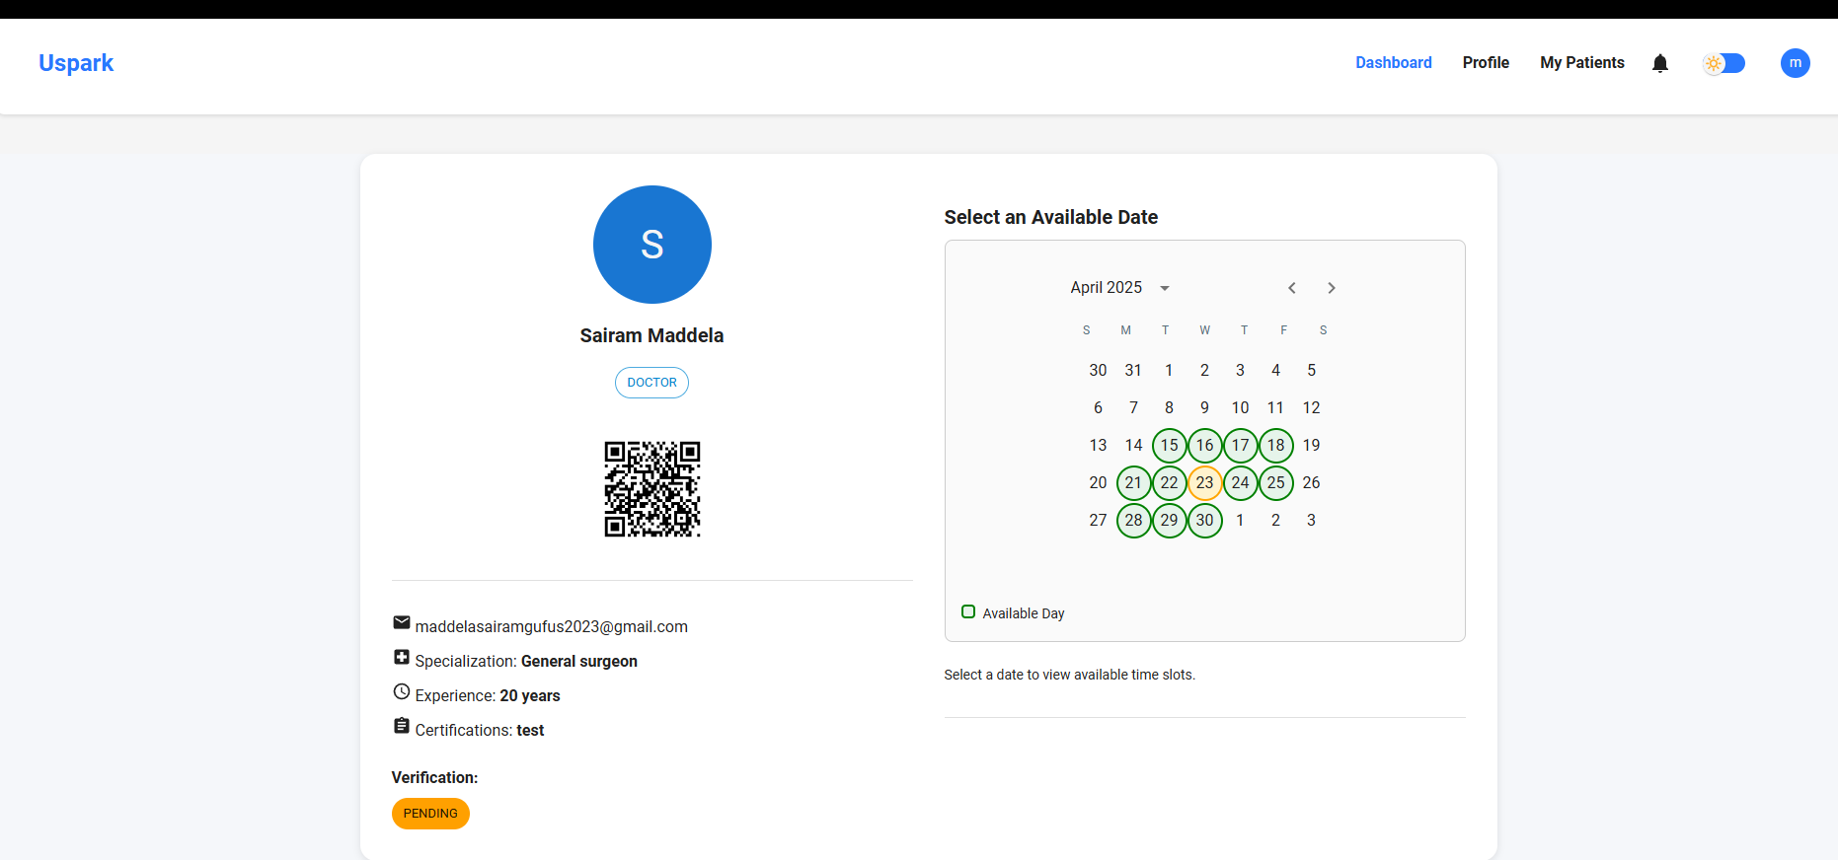
Application Screenshots

Slide 52
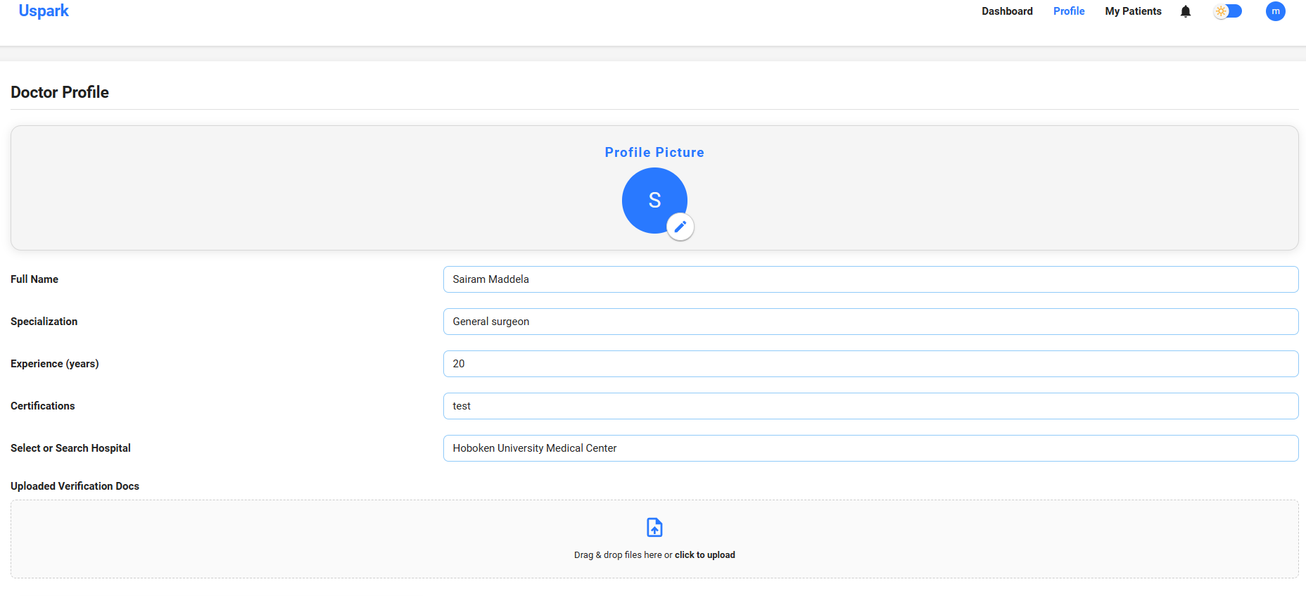
Application Screenshots

Slide 53
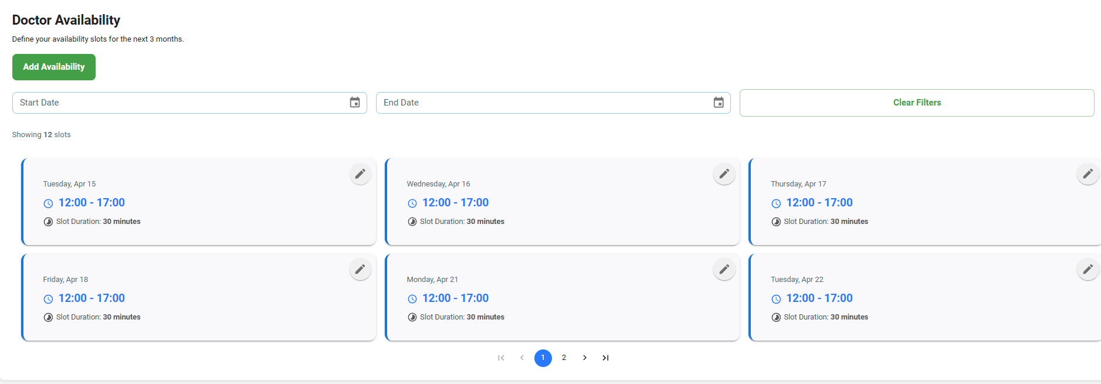
Application Screenshots

Slide 54
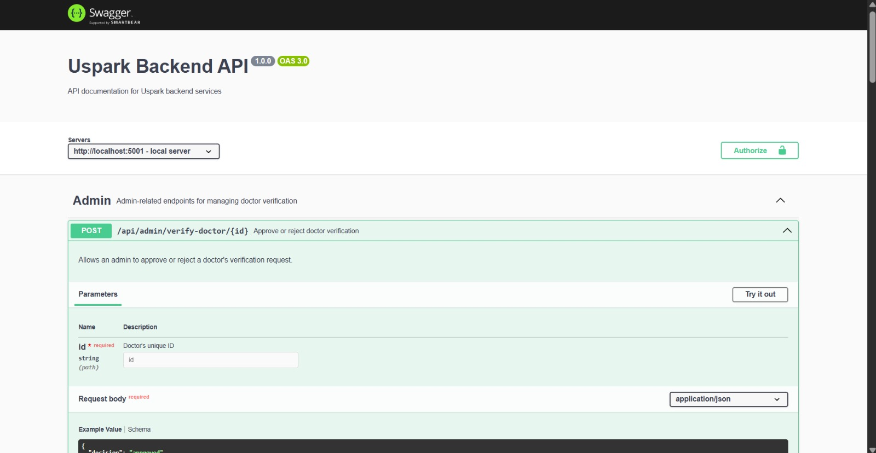
API Screenshots

Slide 55
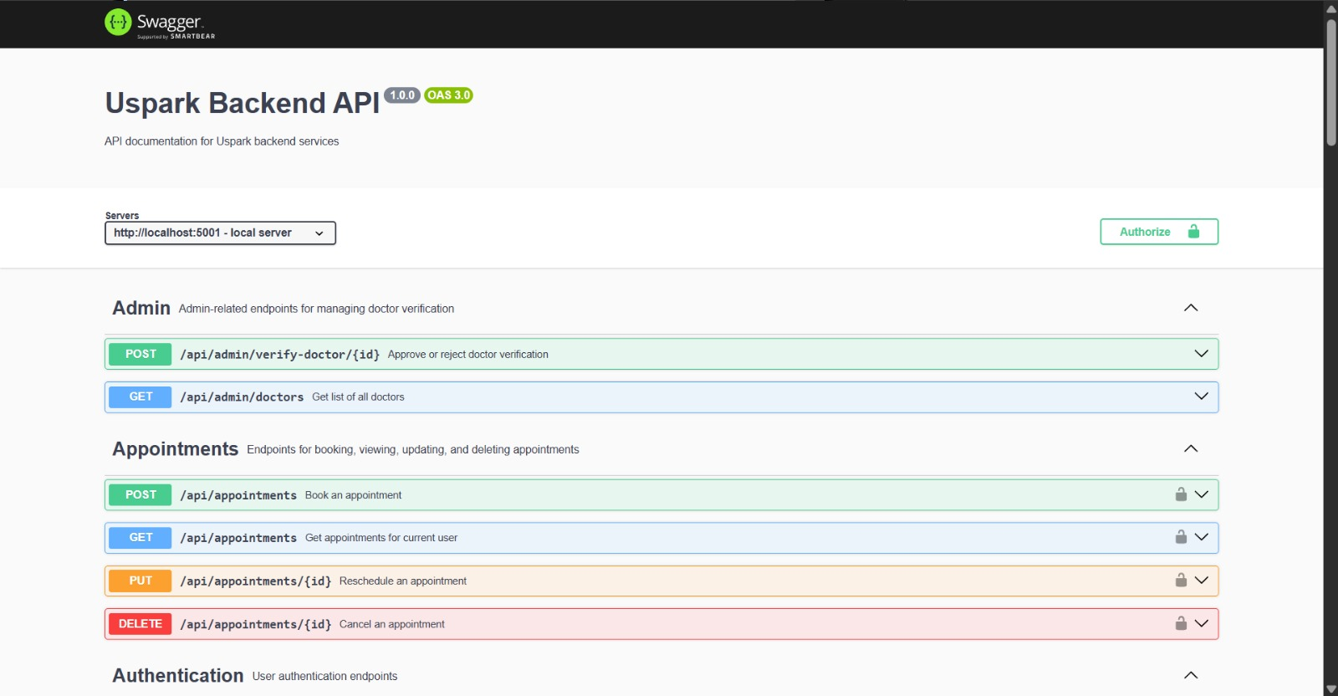
API Screenshots

Slide 56
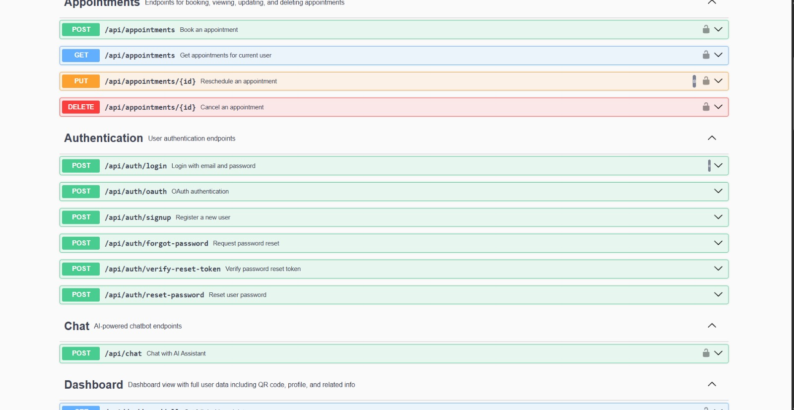
API Screenshots

Slide 57
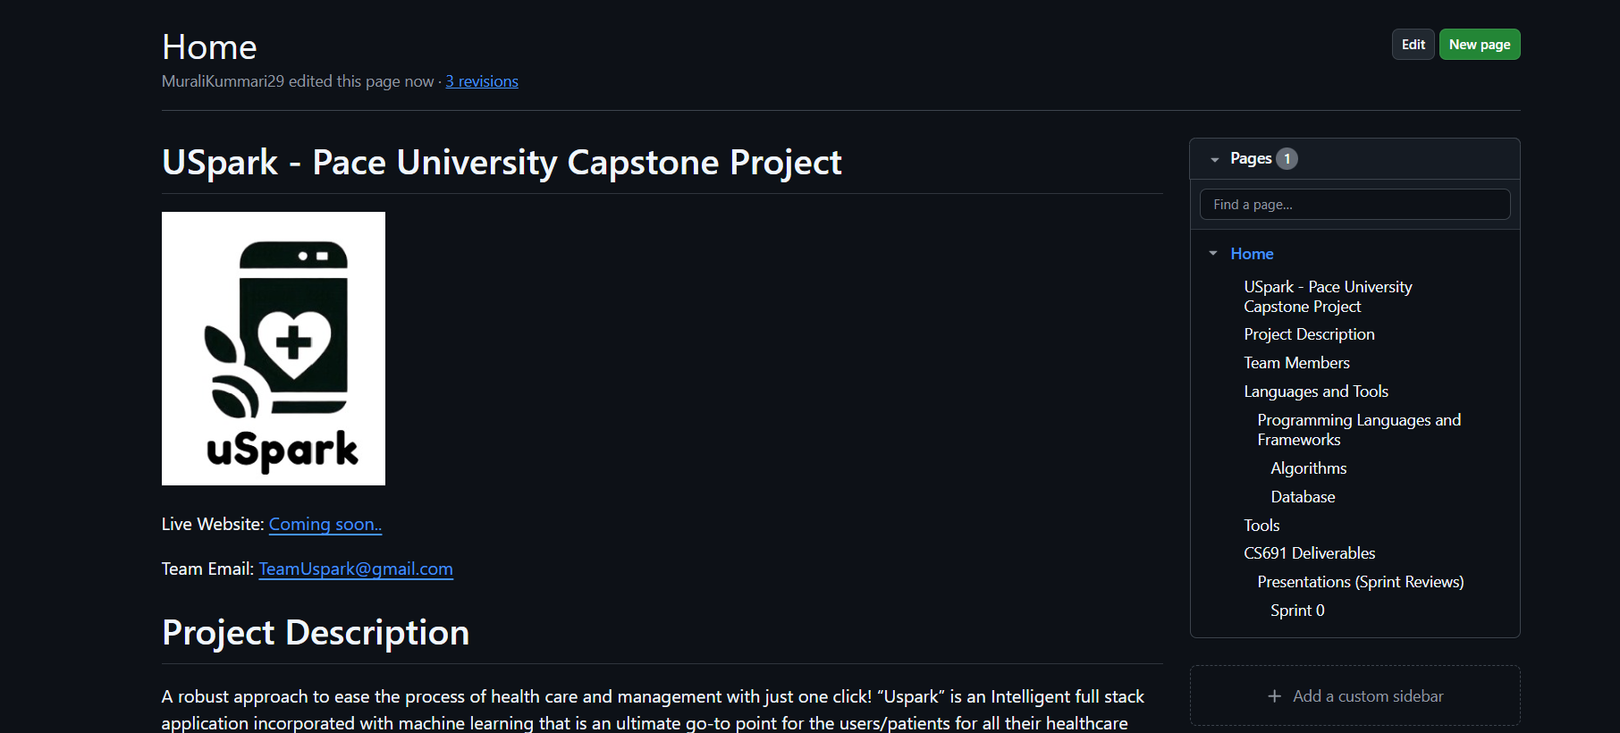
WIKI PAGE
https://github.com/htmw/2025S-RushHour/wiki

Slide 58
THANK YOU
CONTACT US:
teamuspark@gmail.com

